Slide 1
Normal modes in three dimensions
13th November 2018

Slide 2
Waves equation in 3 dimensions
Recall, the wave equation in 3 dimensions can be written as
The solution of the equation can be found from the method of separation of variables.
The general solution, i.e., the wave function, is found to be

Slide 3
Standing waves in rectangular enclosure
Consider a rectangular enclosure as illustrated in the figure, l₁, l₂ and l₃ are lengths of the sides of the rectangular enclosure.
The wave function describing the standing waves inside the enclosure have to satisfy the following boundary conditions.
z
y
l₂
l₃
x
l₁

Slide 4
A particular wave function within the rectangular enclosure
By applying the first boundary condition, φ = 0 @ x = y = z = 0 at all times, the wave function becomes
Likewise, the application of the second boundary condition, φ = 0 @ x = l₁, y = l₂ and z = l₃ at all times, leads to the particular wave function
where n₁, n₂ and n₃ are integers.

Slide 5
Normal mode frequency of standing wave in a rectangular enclosure
Substituting the particular wave equation into the 3 D wave equation, we then obtain
This leads to
Or
Finally, the normal mode frequency ν;
The allowed standing wave must have wave vectors that satisfy this condition.

Slide 6
Normal mode frequency
Recall the normal mode frequency from the previous slide,
The labels; i.e., n₁n₂n₃, need not all have the same value, but can be chosen quite independently of each other. Note that, setting any one of them equal to zero causes the wave function φ to vanish.
Likewise, the wave function can be expressed with the label n₁n₂n₃ as follows

Slide 7
Degenerate standing waves
Recall the relationship of the wave vectors k, k₁, k₂ and k₃,
This implies that standing waves with different composite wave vectors can the same wave vector k, normal mode frequency and subsequently energy. Those standing wave are called “degenerate waves function”.
For example, if l₂ = 2l₁ for any value of n₃, φ_{22n3} and φ_{14n3} are degenerate wave functions.

Slide 8
No. of normal mode frequency in a rectangular enclosure in k space
No. of normal mode frequency, representing the no. of standing waves in the rectangular closure, can be determined from either wave vector space k or frequency space ν.
If we start the analysis with the wave vector relation,
The composite components of the wave vector k
can form three perpendicular axes.
Also, it is noted that the maximum magnitude of the wave vector k
has to be within a sphere of radius k.
k₃
k
k₂
k₁
Wave vector space k

Slide 9
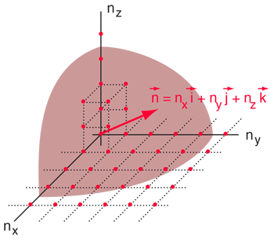
The lowest normal mode
each apparent point corresponds to a possible normal mode.
Consider the lowest normal mode having labels of n₁n₂n₃ = 111, the magnitude of the wave vector k becomes
The end point of the lowest normal mode wave vector is at the corner of a rectangular cell having lengths π/l₁, π/l₂, π/l₃ along k₁, k₂ and k₃, respectively, with a volume π³/l₁l₂l₃ .
There are as many cells as points since each cell has eight points at its corners and each point serves as a corner to eight cells.
Therefore, this suggests that the number of modes can be determined from the ratio of the spherical volume to the volume of a cell.
However, only one octant of the sphere gives a unique set of normal mode.
k₃
π/l₃
k₂
π/l₁
π/l₂
k₁
Wave vector space k
http://hyperphysics.phy-astr.gsu.edu/hbase/quantum/rayj.html

Slide 10
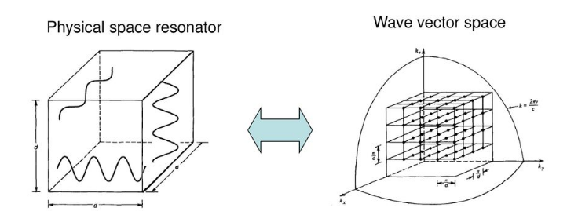
The number of normal modes
The number of normal modes can be calculated from
https://slideplayer.com/slide/13669157/

Slide 11
No. of normal mode frequency in a rectangular enclosure in ν space
The wave vector space can be transformed into the frequency ν space as follows
Likewise, the frequency space is composed of composite
frequency components ν₁, ν₂ and ν₃ as shown in the figure.
The maximum normal mode frequency lies within the sphere
of radius ν.
ν₃
ν
ν ₂
ν ₁
frequency space ν

Slide 12
The lowest normal mode frequency
This lattice cell correspond to the lowest normal mode frequency
ν₁₁₁.

Slide 13
How many normal modes can exist in the frequency range ν to ν + dν?
The total corresponds to the number of possible points (n₁, n₂, n₃) lying in the positive octant between two concentric sphere of radii ν and ν + dν.
The total number of possible points or cell will be
Note that the mode density is given by
Notes:
Note that this result, per unit volume of the enclosure, is independent of any particular system.

Slide 14
Application of mode density :
Rayleigh-Jean radiation law
Rayleigh and Jean attempted to find an oscillator model describing the EM radiation from a hot body of temperature T.
The average energy of each normal mode is given as 2kT.
Therefore, the EM energy radiated by a hot body of temperature T in the small frequency interval ν to ν + dν may be written as
Black body radiation curves described by Planck (dashed lines) and Rayleigh-Jean (solid line)
This relation leads to the ultra-violet catastrophe.
Notes:
The energy radiated per frequency interval dv may be considered as the product of the number of normal modes or oscillators in the interval dv and an energy contribution of kT from each oscillator for each plane of polarization.

Slide 15
Application of mode density :
Debye theory of specific heat of a solid
By definition, the specific heat is the amount of heat energy that must be supplied to a mole of solid to raise its temperature by one degree.
Debye realized that the solid should be treated as a continuum instead of looking into the vibrations of the individual atoms as was done by Einstein.
He considered the thermal vibrations of atoms in a solid lattice in terms of a vast complex standing waves due to coupled oscillation over a great range of frequencies.
In Debye’s model, each atom was allowed two transverse vibrations (perpendicular planes of polarization) and one longitudinal vibration.
The possible mode density in the frequency interval ν to ν + dν is given by
C_{T} and C_{L} are the transverse and longitudinal velocities.
Notes:
Einstein’s model considered that each oscillator vibrates at the same frequency and no coupling between each other whatsoever.

Slide 16
Debye’s approximation
Once the mode density in the frequency range ν to ν + dν and an average energy (form Planck’s law) are known. The total energy for a solid volume V_{A} is then
The total energy per one mole of atoms of the solid over all permitted frequencies is then
Where ν_{m} is the maximum frequency of the oscillations.
The total number of modes can be written in terms of the maximum frequency of the oscillations as follows:

Slide 17
Because the amount of solid under interest is one mole, there are N atoms (Avogadro’s number).
Each atom has three allowed oscillation modes; i.e. two transverse and one longitudinal modes.
Thus the mode density (or the number of normal mode frequencies per unit volume) for one mole of a solid volume V_{A} is given as
By substituting the above expression into E_{A} from previous slide,

Slide 18
The values of E_{A} becomes
The molar specific heat of the substance at constant volume can be determine once the variation of E_{A} with temperature has been found.
In general, the specific heat is calculated from
The specific heat of aluminium calculated by this model is compared with experiment results shown in the next slide.

